Slide 1
Contemporary Tourism
Consequences of Visitation

Slide 2
Lecture Objectives
Be able to appreciate some of the positive and negative perceptions of tourism’s effects
Appreciate that although the contemporary destination is a focal point of attention to the impacts of tourism that effects occur over all stages and parts of the geographical tourism system
Understand that the consequences of tourism are contextual and situational
Understand the potential significance of change for the consumption and production of tourism
Be able to identify some of the key factors that affect the assessment of the effects of tourism

Slide 3
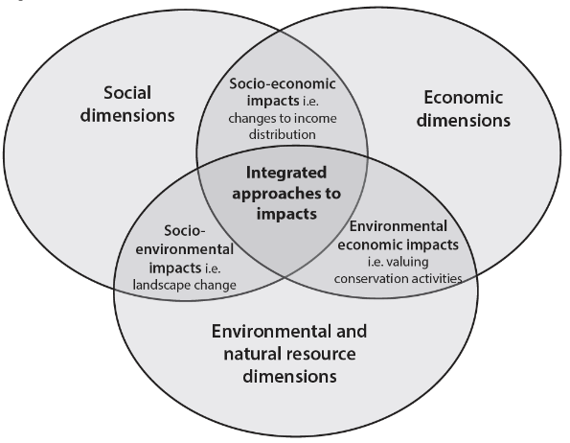
Traditional categories of tourism impact

Slide 4
Consequences of Visitation
Awareness of consequences vital for business and responsible tourism
Significant debate on the consequences
Consequences all linked
Consequences all liable to interpretation
Change is inevitable
Change happens at different times and points in the visit cycle

Slide 5
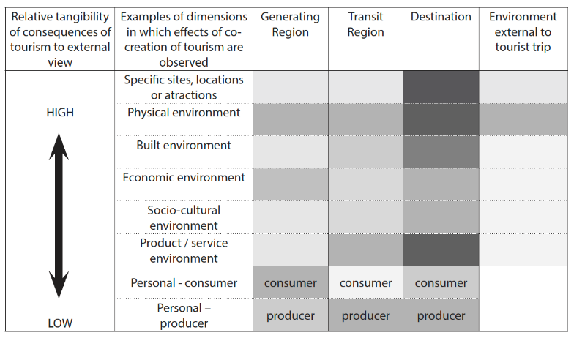
Consequences of tourism

Slide 6
Overcrowding
Five main challenges associated with overcrowding:
Alienated local residents
Degraded tourist experience
Overloaded infrastructure
Damage to nature
Threats to culture and heritage

Slide 7
Assessing the Consequences
Context and situation - each location or site will have different elements and characteristics
Key issues
Definitions: What is being examined?
Scale: What is the scale of analysis and where are boundaries drawn in any study
Baseline information: What is the starting point? What existed before tourism’s impacts are assessed?
Monitoring: Is there ongoing monitoring of impact? Over what timescale and intervals?

Slide 8
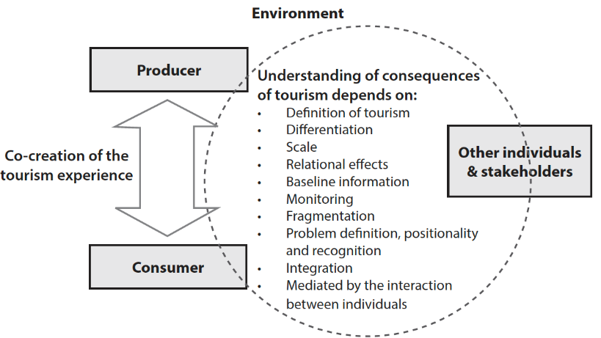
Understandng consequences

Slide 9
Integrative Assessment
Institutional approaches and methods
Post- or multi-disciplinary approaches
Collaborative approaches
Multiple stakeholders

Slide 10
Components of integrative assessment
Agree on a common purpose;
Ensure process is inclusive and transparent;
Allowing participants to design the process;
Promoting joint fact finding and creative problem solving;
Insist on accountability;
Develop an action plan; and
Develop collaborative leadership

Slide 11
Why is collaborative and integrated assessment needed?
Increased competition for resources
Complexity of natural and social systems
Broad scale participation is often better suited to fostering understanding and commitment among a large number of decision makers
A collaborative approach reduces waste and duplication, reduces conflict and helps share data and expertise

Slide 12
Relationships between Tourism and Environment
Conflict: when tourism is regarded as having a detrimental impact on the environment by those at the destination.
Coexistence: tourism has neither negative or positive effects. This situation rarely remains static
Symbiotic: in which tourism positively contributes to the environment and vice versa.

Slide 13
Summary of Key Points
Co-creation of tourism experiences means that consequences are situational and contextual
Different perceptions of impact from different stakeholders
For effective management agreement is need on what the problem is
Integrative and collaborative assessment of tourism’s impacts is the ideal

